Slide 1
Competition: Outside of the Plan Room
PRESENTED BY:
Joe Benedict, Construction Exchange of Buffalo & WNY

Slide 2
THANK YOU TO OUR SPONSORS

Slide 3
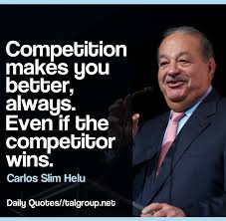
Competition: Outside of the Plan Room
Competition is Essential!

Slide 4
Competition: Outside of the Plan Room
Our Benefits
Online Planroom
Physical Planroom
Construction Exchange U
Safety Services
Workers Compensation Safety Group
Industry Advocacy
Newsletter
BWNY Magazine
Affinity Programs
Relationship Building
Company Promotion

Slide 5
Competition: Outside of the Plan Room
What Does the Competition Look Like
Other Construction Associations
Chambers of Commerce
Specialized Advocacy Groups
Networking Groups
Industry Publications

